Slide 1
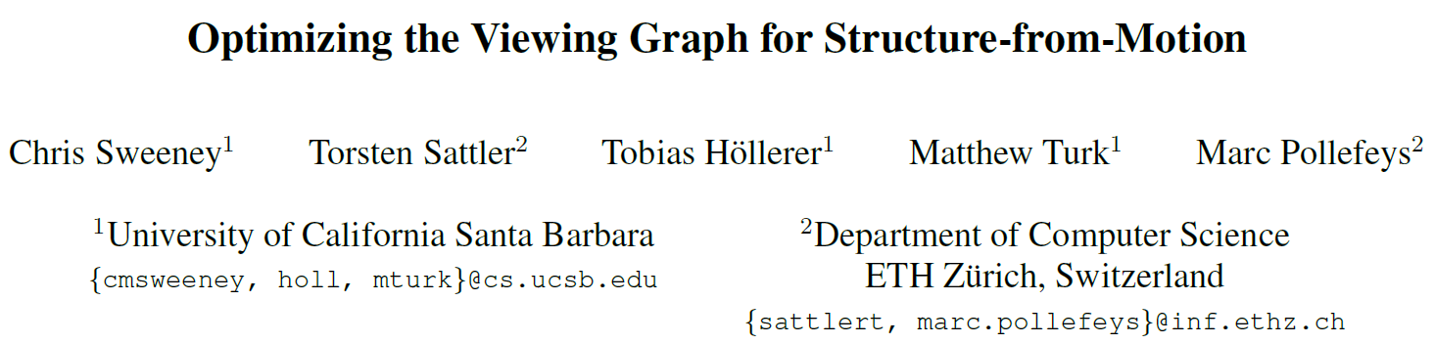
International Conference on Computer Vision (ICCV),2011.
Reporter: Ge Linlin
Date: 2019.05.27

Slide 2
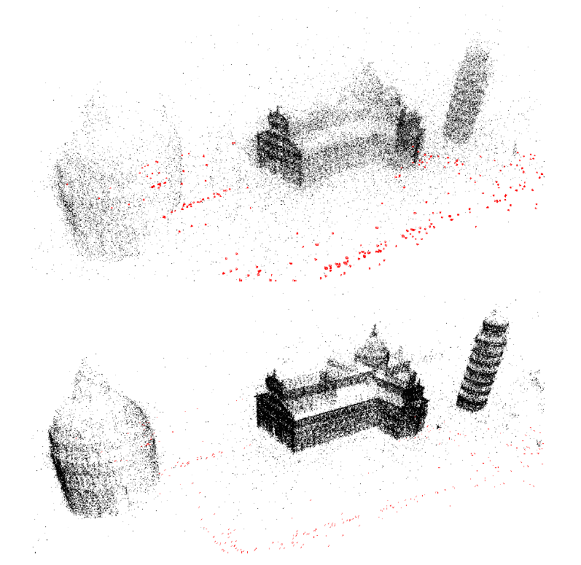
1. Introduction
Algorithm: MRPCA with the full name Moving Robust Principal Component Analysis.
Issues: Points’ Normal Estimation, Outlier Removal, Sharp Feature Preservation.

Slide 3
1. Introduction
Contributions:
It is the first global SFM pipeline capable of handling uncalibrated image sets;

Slide 4
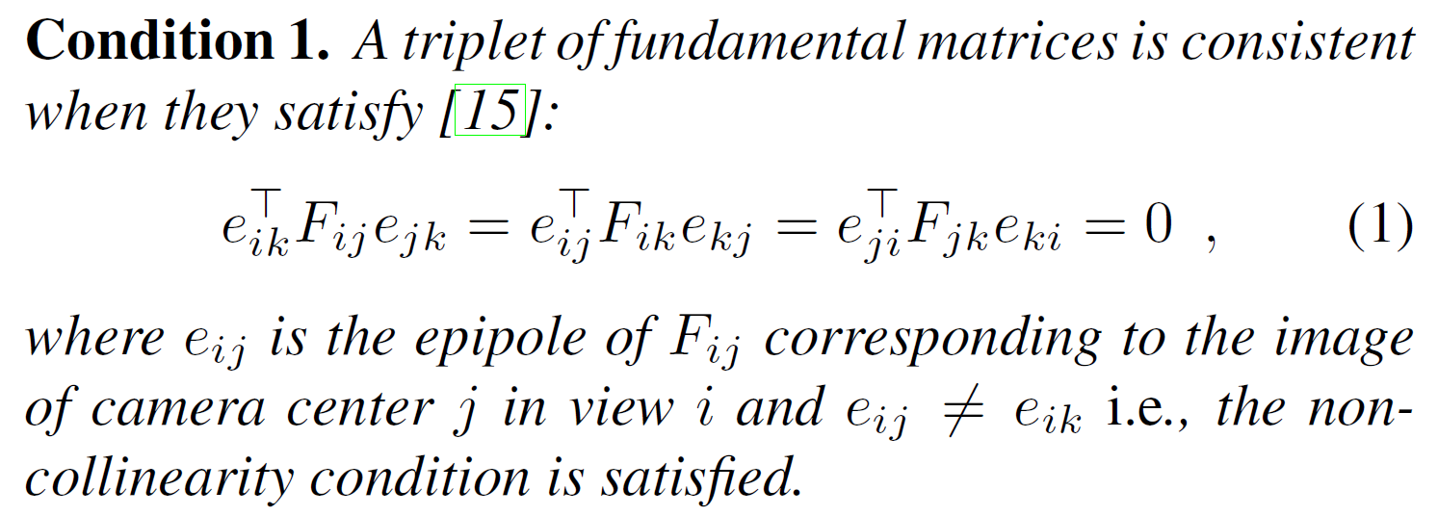
2. Sufficient Condition for Consistency

Slide 5
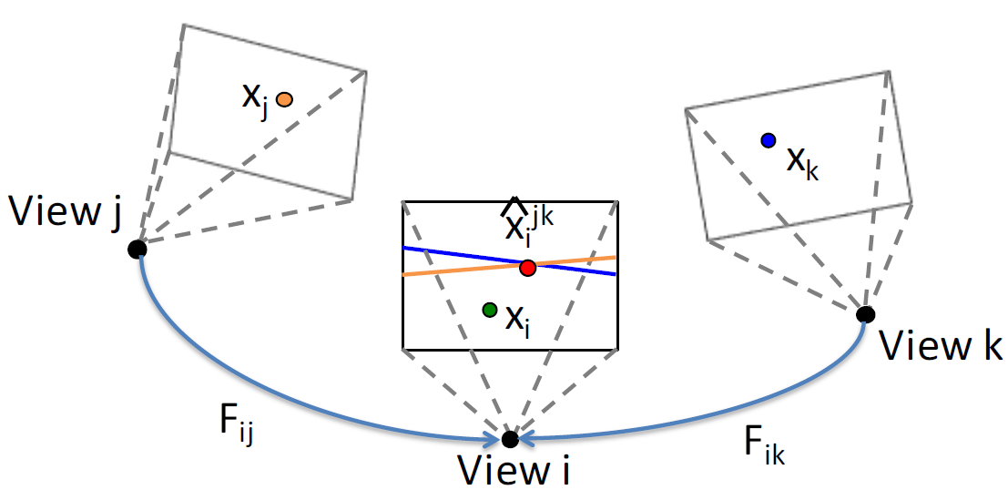
2. Sufficient Condition for Consistency

Slide 6
3. Numerical Instabilities
Condition 1
The transfer point lies on the trifocal plane of the image i, j and k.
Solution
Do not consider points where the two transfer lines are nearly parallel or the transfer lines lay near the epipole.
The latter scenario can be checked by examining the norm of the transfer line.
Condition 2
The tree camera centers are collinear.
Solution
Remove collinear triplets where the epipoles are equal.

Slide 7
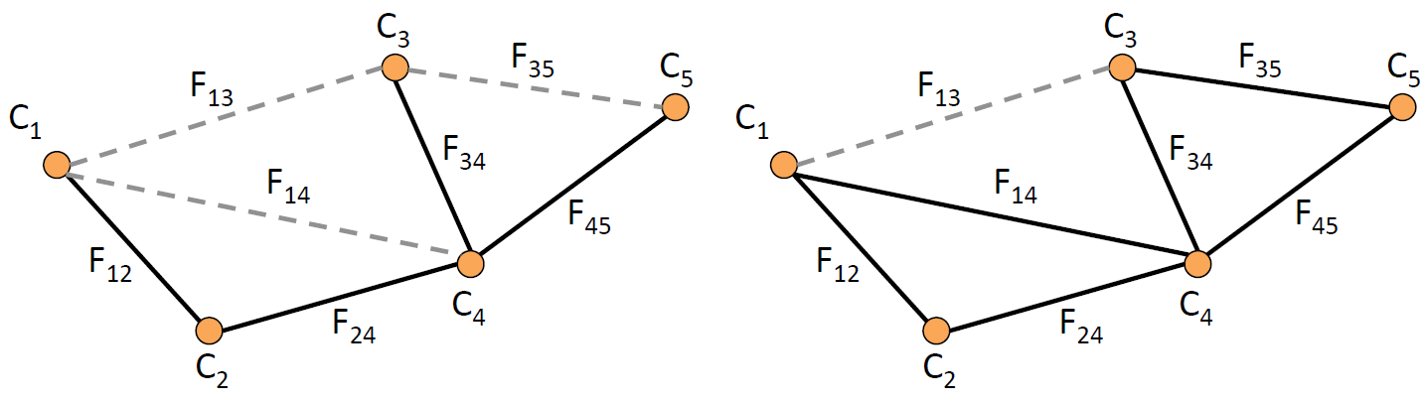
4.1 Viewing Graph Optimization
Target
Find a minimal set of edges that provide sufficient coverage over all views in the viewing graph.

Slide 8
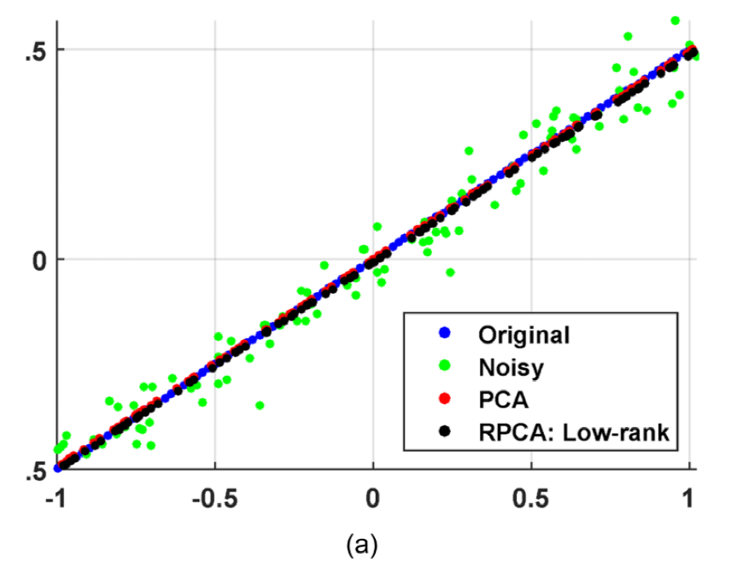
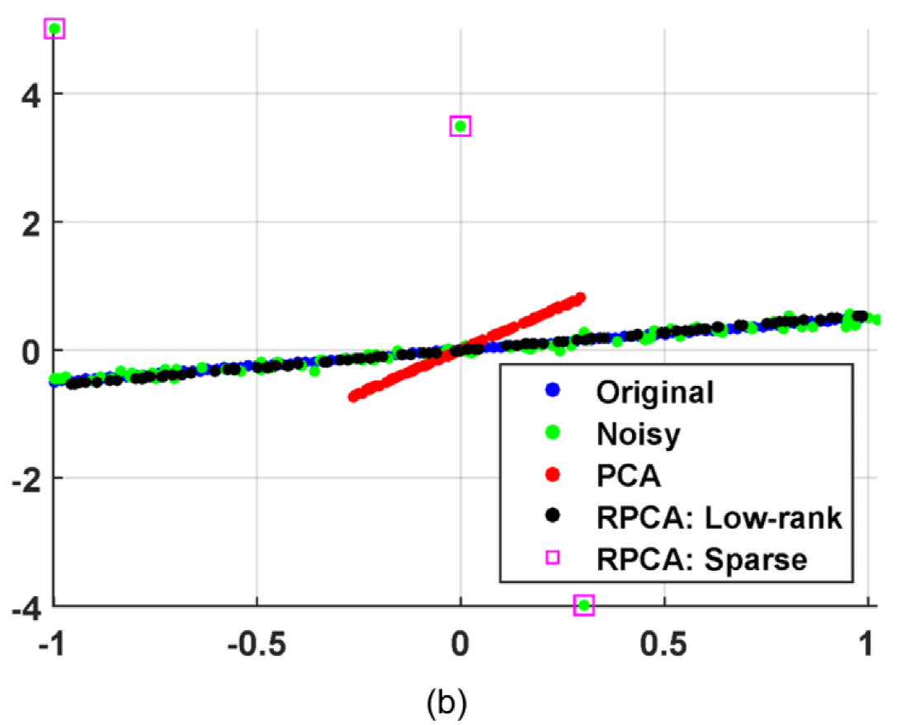
2. RPCA ( Robust Principal Component Analysis)
Why this paper is based on RPCA rather than PCA?
Compared to PCA, RPCA is more robust when facing outlier.
Without Outlier
With Three Outlier

Slide 9
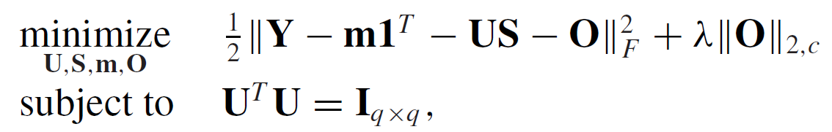
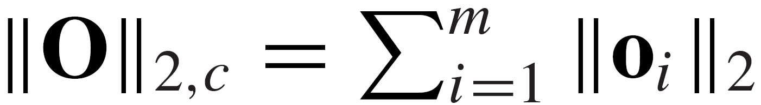
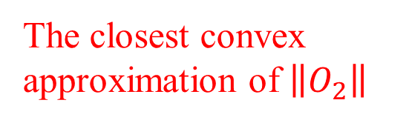
2. RPCA
Assumption:
Suppose that it is a linear problem, so a linear model estimation model can be used.
Outlier-aware Factor Analysis Model:
Objective Function:
Applications:
Outlier-sparsity Control
Online Robust Subspace Estimation
Robust Spectral Clustering
$$x_{i}=y_{i}+o_{i}=m+Us_{i}+e_{i}+o_{i} i=1,⋯,N$$
Where,
The closest convex approximation of $\left\|O_{2}\right\|$

Slide 10
3 MRPCA (Moving Robust Principal Component Analysis)
MRPCA is an algorithm which applied RPCA to point cloud denoising.
(1) A factor analysis model to process local neighborhoods;
(2) A global approach to process overlapped regions.

Slide 11
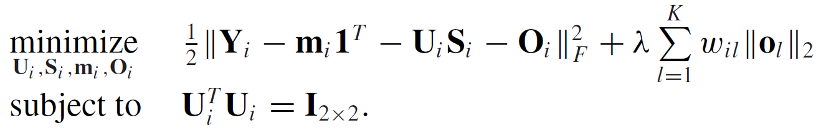
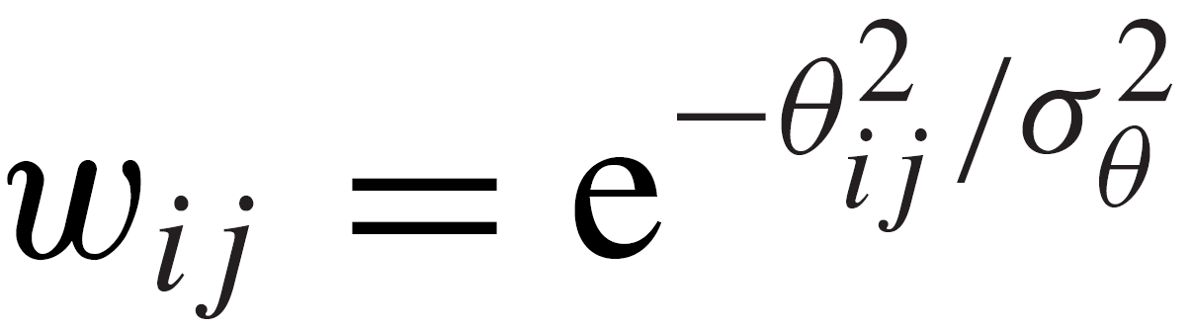
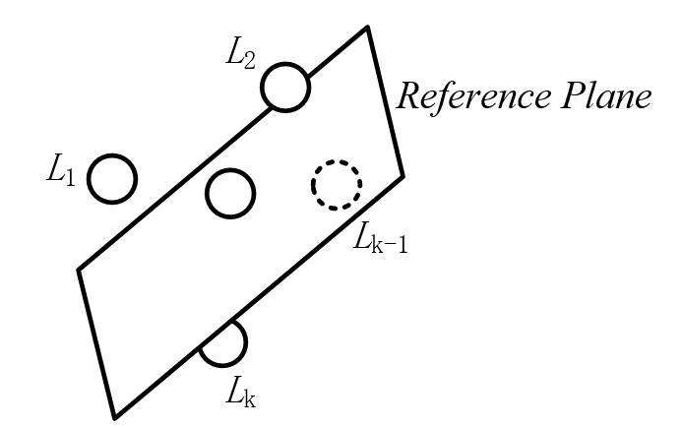
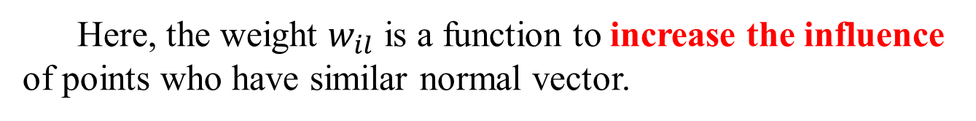
3.1 MRPCA —— Local Neighborhoods Processing
Here, the weight $w_{il}$ is a function to increase the influence of points who have similar normal vector.
Gaussian Kernel Function
or
Radial Basis Function
Angle between
Two Points’ Normals

Slide 12
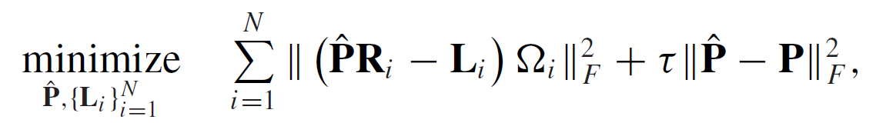
3.2 MRPCA —— Overlapped Regions Processing
Local Data Error
Point Cloud Error

Slide 13
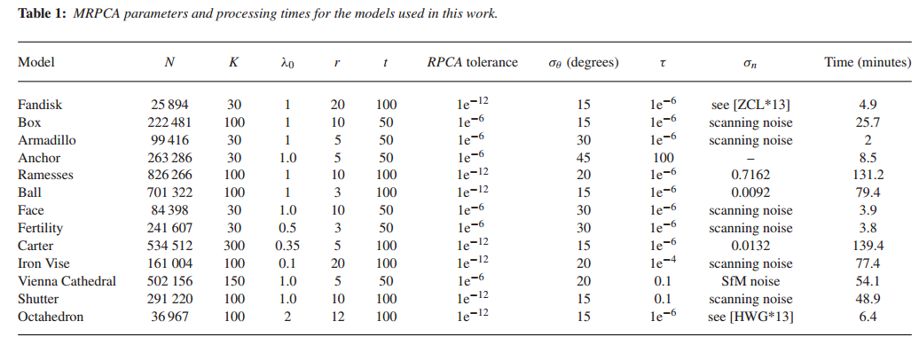
3.3 MRPCA —— Parameters and Processing Time
The maximum iteration times of RPCA solver
The maximum iteration times of MRPCA

Slide 14
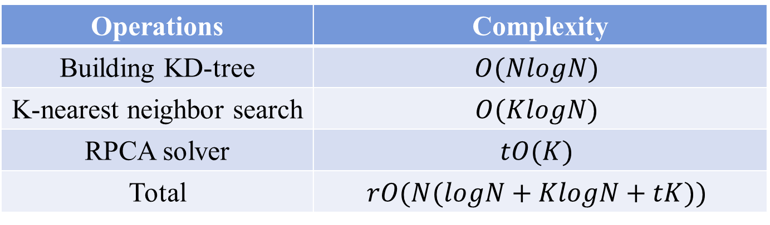
3.4 MRPCA —— Computational Complexity
Operations | Complexity
Building KD-tree | $$O(NlogN)$$
K-nearest neighbor search | $$O(KlogN)$$
RPCA solver | $$tO(K)$$
Total | $$rO(N(logN+KlogN+tK))$$
The maximum iteration times of MRPCA
The size of neighbourhoods
The maximum iteration times of RPCA solver

Slide 15
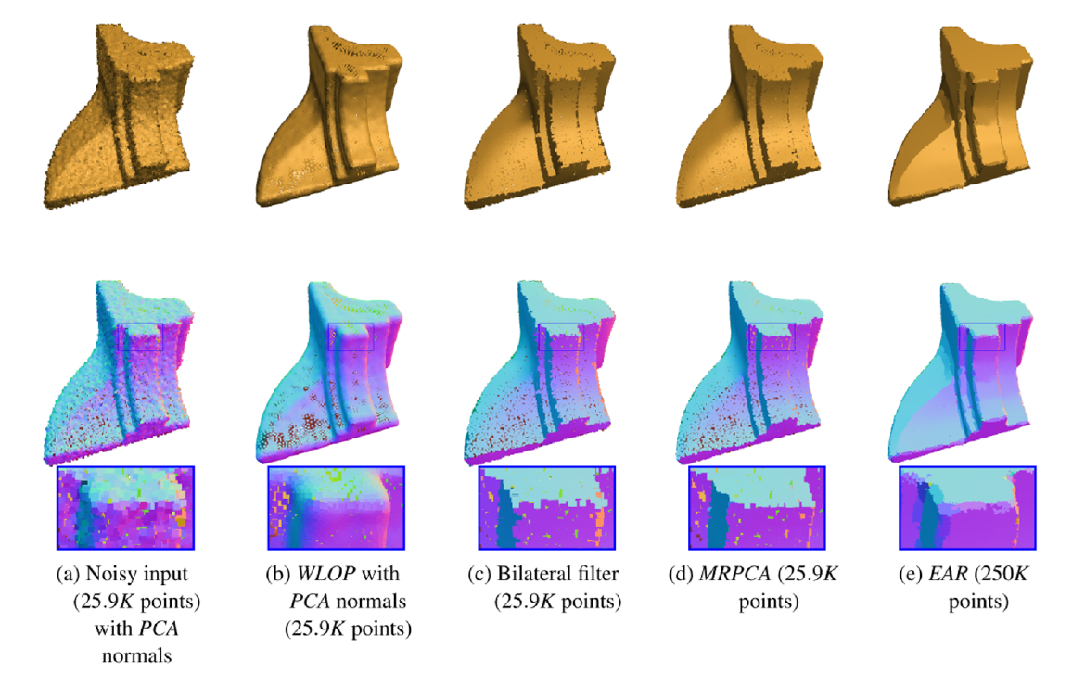
4. Results —— Handling Sharp Features

Slide 16
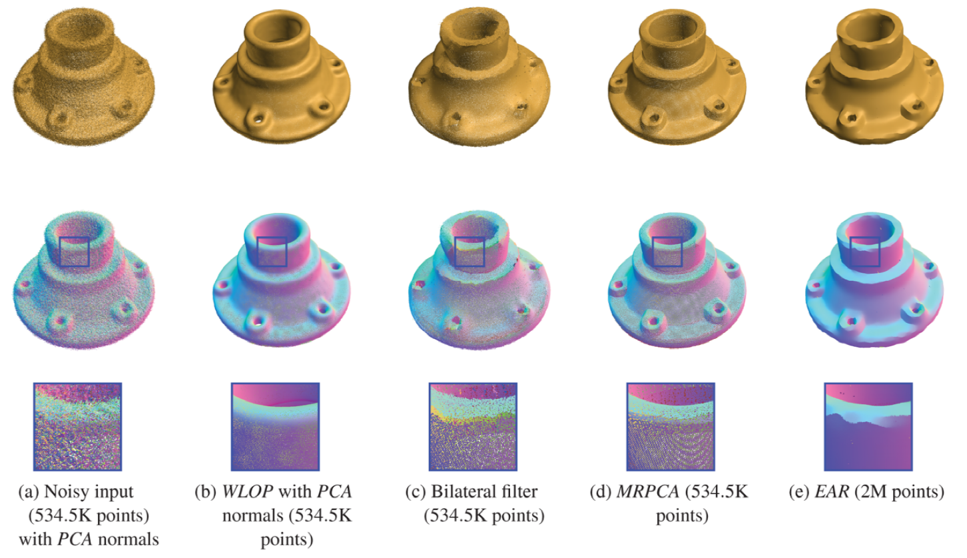
4. Results —— Handling SFM Model

Slide 17
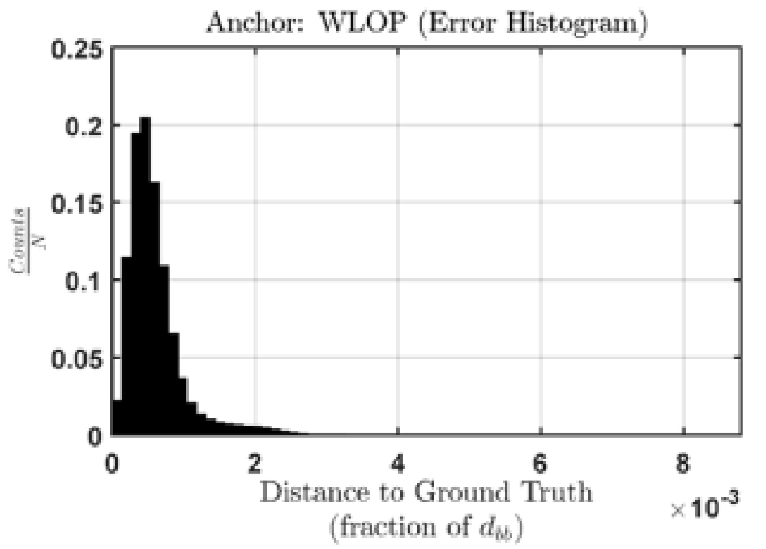
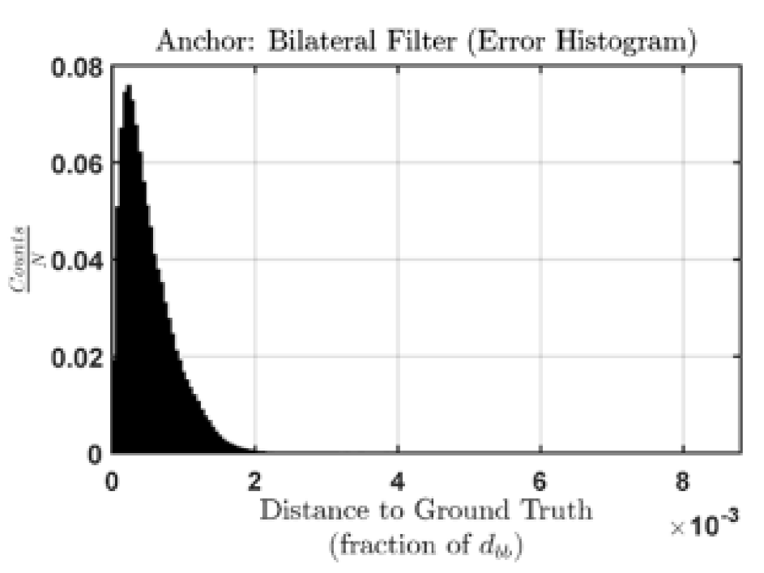
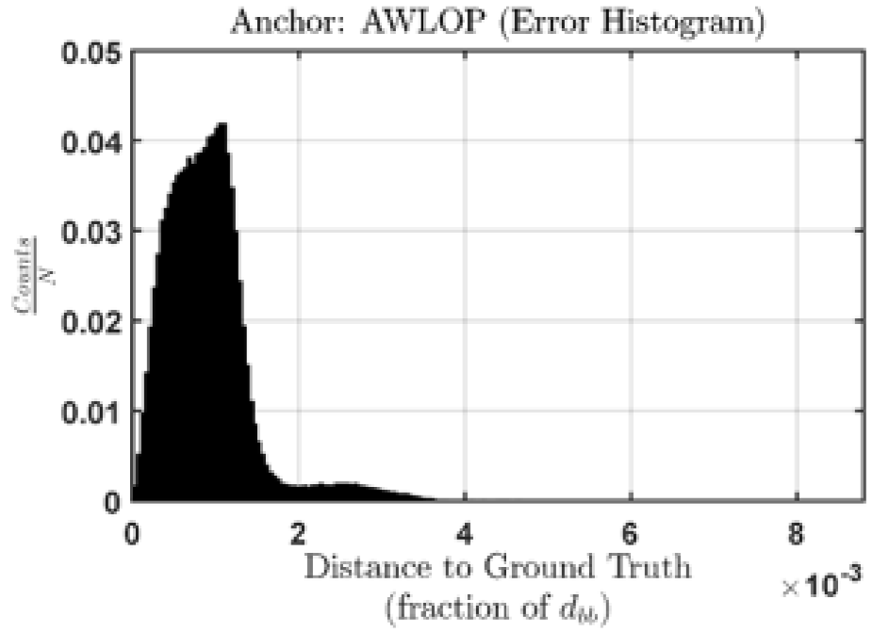
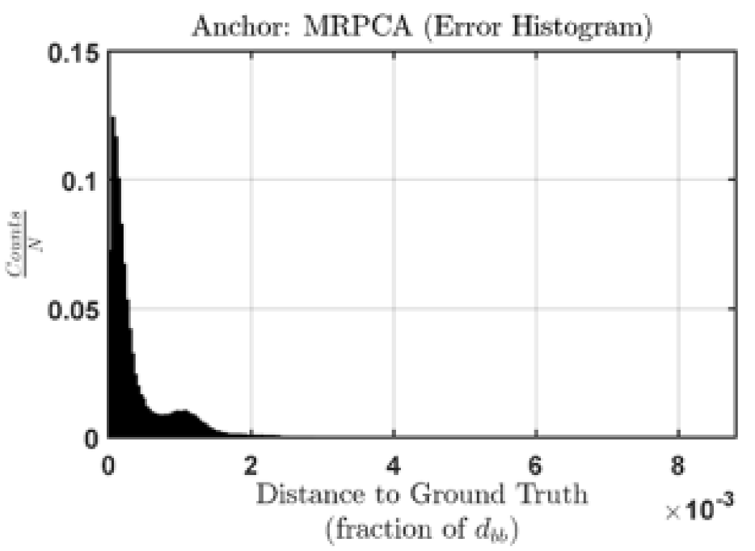
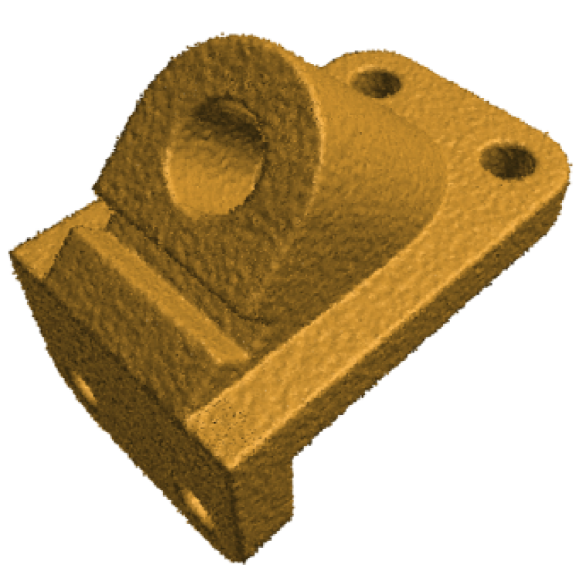
4. Results ——Error Analysis

Slide 18
5. Limitations
When facing sharp features and high noise levels, computation of MRPCA will considerably increase due to a larger neighbourhood.
Normals estimated by RPCA are not stable.

Slide 19
5. Conclusion
MRPCA is effective in denoising point cloud with and without sharp feature;
MRPCA is outperform well-known approaches such as the bilateral filter, WLOP and AWLOP;
L1-norm worked better than Frobenius norm, but Frobenius norm is used in this article to decrease computation;
The neighbourhood size is obtained from a function which is relevant to local point density.

Slide 20
Q1: What is SO(3) rotation and O(3) matrices?
Q2: Why the epipole is in the null space of fundamental matrix？
Q3: What is the norm of transfer line?

Slide 21
Thanks!

